Slide 1
Advertising Positioning
Feng Fan, Zhang Yue, and Curtis Kelsey

Slide 2
Overview
Our Dataset
Method
Data Trends
Results
Summary

Slide 3
Dataset
Experimental Transaction Data from TaFeng Warehouse
817,741 transactions
3 months of data
Each record is a transaction and each transaction has only one associated product

Slide 4
Dataset Fields
1: Transaction date and time (yy-mm-dd,time)
2: Customer ID (class)
3: Age: 10 possible values,
A <25,B 25-29,C 30-34,D 35-39,E 40-44,F 45-49,G 50-54,H 55-59,I 60-64,J >65
4: Residence Area: 8 possible values,
A-F: zipcode area: 105,106,110,114,115,221,G: others, H: Unknown
5: Product subclass (class)
6: Product ID (class)
7: Amount (numeric)
8: Asset (numeric)
9: Sales price (numeric)

Slide 5
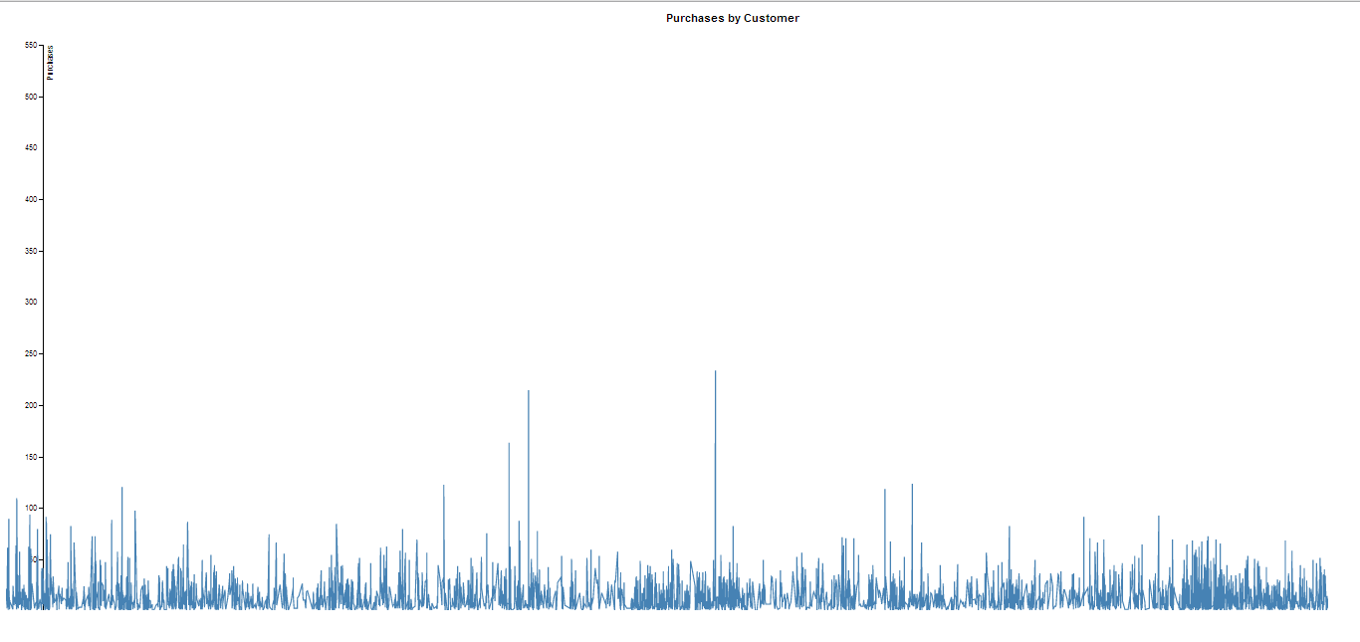
Purchases by Customer
Calculate the total items bought by each customer
Xlabel: customer_ID
Ylabel: number of items

Slide 6
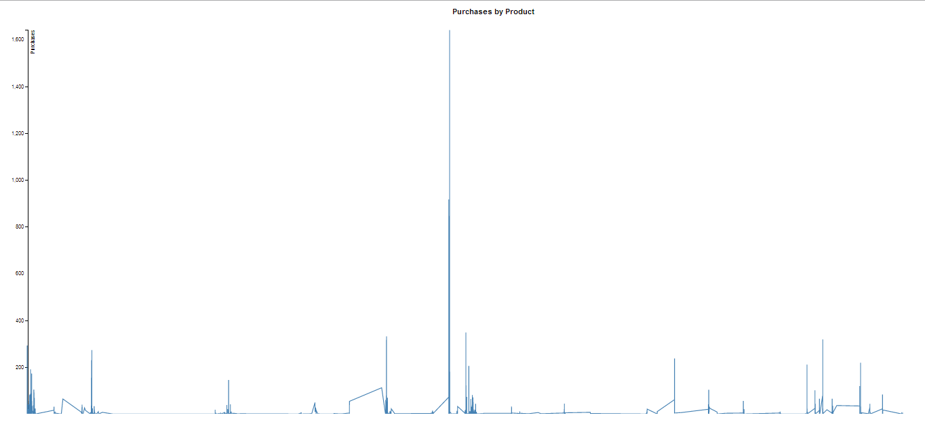
Purchases by Product
Calculate the total items sold by each product
Xlabel: product_ID
Ylabel: number of items

Slide 7
Frequent Itemset Mining
What Support did we use? (Based on all transactions)
150 purchases per 817,741
Approx 0.02%
Dataset only allows 1-item frequent itemsets
How do we increase the amount of information we can collect?
Cluster transactions by date and treat each cluster as a single transaction
Transactions are reduced to 345,957

Slide 8
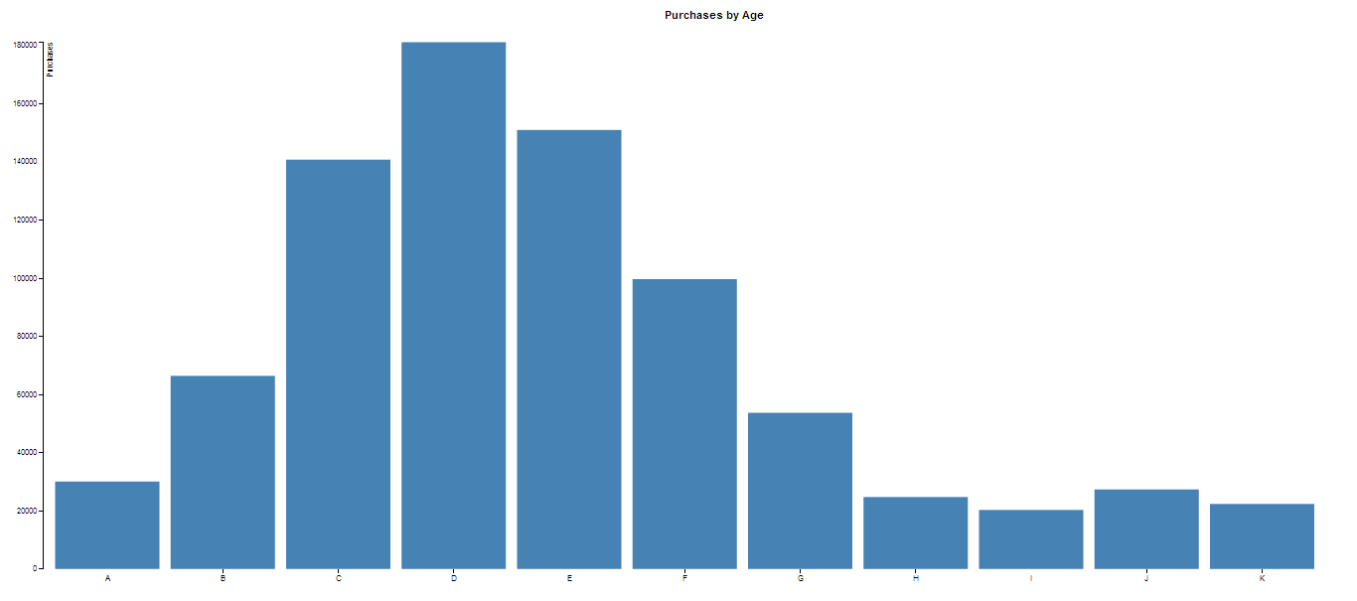
Purchases by Age
Calculate the total items bought by different age
Xlabel: age
Ylabel: number of items

Slide 9
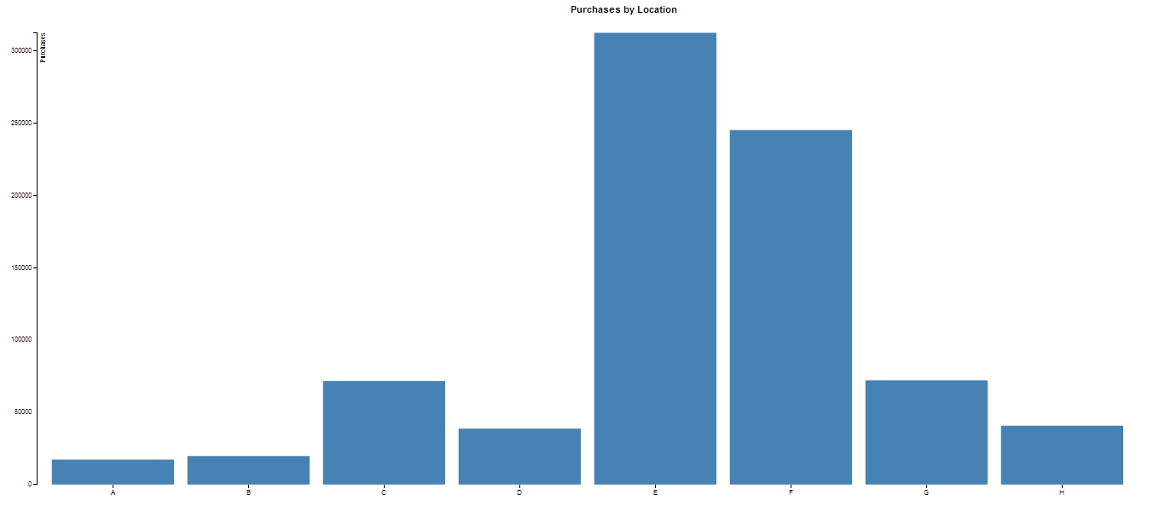
Purchases by Location
Calculate the total items bought by different location
Xlabel: location
Ylabel: number of items

Slide 10
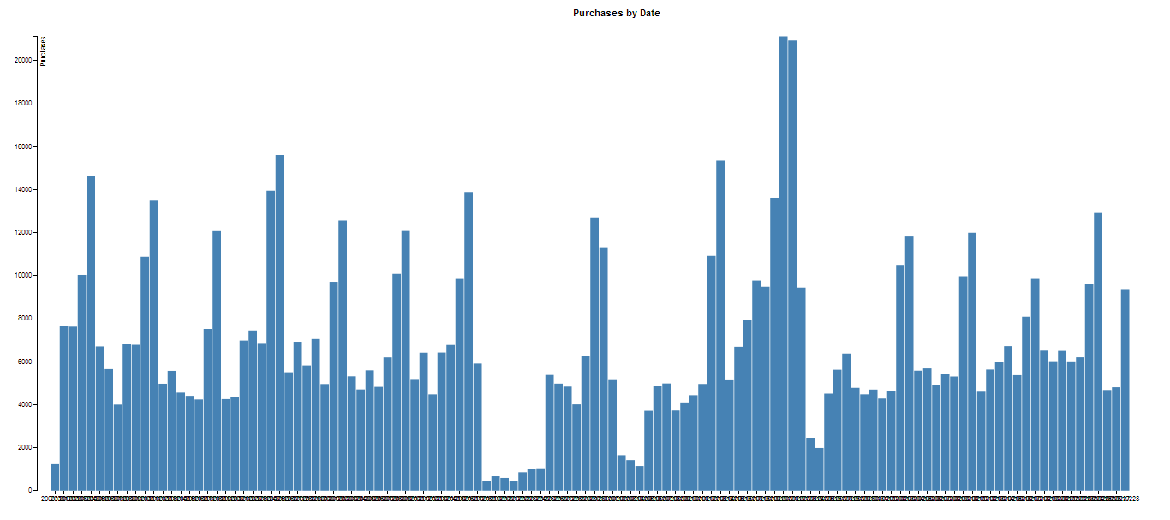
Purchases by Date
Calculate the total items bought on each date
Xlabel: date
Ylabel: number of items

Slide 11
Finding Trends in Data
What may cause the low sales in the graph?
Do the sales seem to be cyclic?
Does the location graph make sense?
How about the age graph?

Slide 12
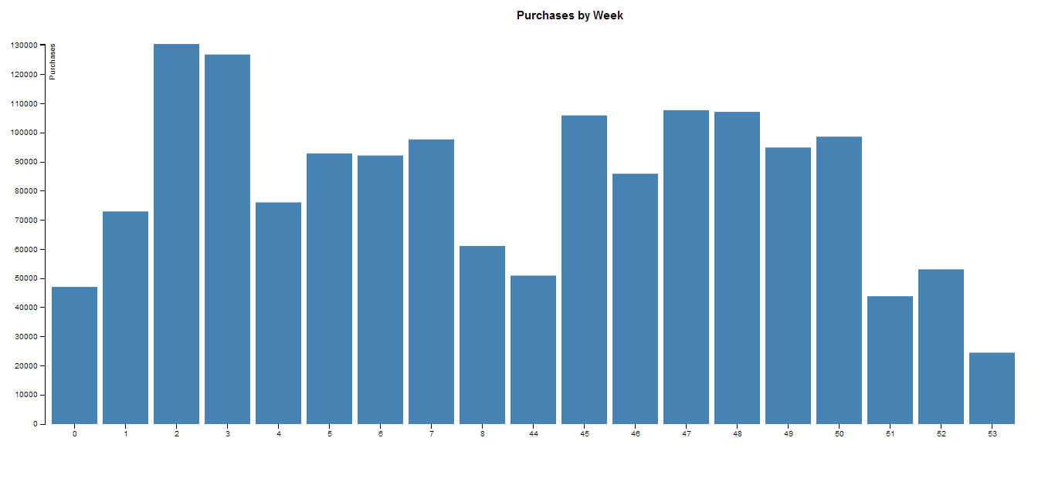
Purchases by Week
Calculate the total items bought during each week
Xlabel: week
Ylabel: number of items

Slide 13
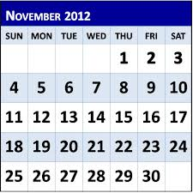
Number of Weeks
In the picture November has 30 days so we have 5 weeks.
A single month may have 4-6 weeks in it.
In total, we have 19 weeks.

Slide 14
Association Rules
age=J productID=4710085120161 13 ==> residence=E 13 acc:(0.99128)
age=K productID=4710063312168 13 ==> residence=H 13 acc:(0.99128)
age=J productID=4710171021327 12 ==> residence=E 12 acc:(0.99057)
age=K productID=4711258001256 10 ==> residence=H 10 acc:(0.98821)
age=H productID=4715545050293 9 ==> residence=E 9 acc:(0.9861)
age=B productID=4710058278059 8 ==> residence=E 8 acc:(0.98273)
age=D productID=4711300983370 8 ==> residence=F 8 acc:(0.98273)
age=I productID=4711001302104 8 ==> residence=E 8 acc:(0.98273)
age=A productID=4711258002505 7 ==> residence=E 7 acc:(0.97714)
age=C productID=4710088433343 7 ==> residence=E 7 acc:(0.97714)

Slide 15
Advertising rules
Date: to find the day which has the largest transaction
Product: to find the product who sold the best
Customer: to find some people who frequently buy products
Age: to find the range of age who most likely to buy products
Location: to find the location where buy the most of products
Association rules: We use this information in business to make marketing decisions. For example, if we already know the area E is saturated with our product 4710085120161 , then we do not need to put more money into advertising for this area. We already know this area has purchased 4710085120161 a lot.

Slide 16
Summary
Our Dataset
Method
Data Trends
Results
Summary

Slide 17
References
TaFeng data set, Artificial Intelligence for Investigating Anti-cancer solutions, Institute of Information Science, Academia Sinica, Taiwan (http://aiia.iis.sinica.edu.tw/index.php?option=com_docman&task=cat_view&gid=34&dir=DESC&order=date&limit=5&limitstart=5)

Slide 18
Questions?

